Slide 1
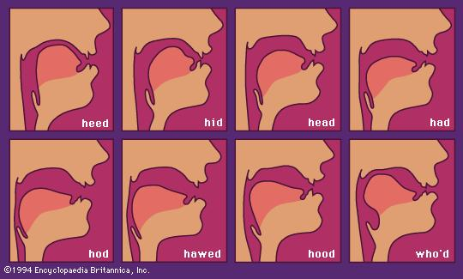
Week 3: Phonetics II
Rebecca Starr EL1101E
30/1/25 NUS AY2024-25

Slide 2
Today
Introducing Vowels
Vowels in US, UK, and Singapore English
Stress

Slide 3
Reminder: Consonants vs. Vowels
Consonants: airflow through the oral cavity is obstructed in some way.
Vowels: airflow through the oral cavity is not obstructed.

Slide 4
Reminder: Three key features capture consonants
1) Voicing (voiced vs. voiceless)
2) Place of articulation
Where is the air flow obstructed?
Bilabial, labiodental, interdental, alveolar, post-alveolar, palatal, velar, glottal
3) Manner of articulation
How is the air flow obstructed?
Stops (plosives and nasals), fricatives, affricates, approximants (liquids and glides)

Slide 5
Can we use the same features for vowels?
All vowels (in English) are voiced, so voicing is not a useful feature in distinguishing vowels.
What about place of articulation? Are there bilabial vowels?
What about manner of articulation? Are there fricative vowels?

Slide 6
Can we use the same features for vowels?
We do position our articulators differently for different vowels, but not in the same way as for consonants.
While some languages do contrast nasal and oral vowels, other manner features do not apply.
So, we need some new features.

Slide 7
What features are important for vowels?
Say “MEE MOO MEE MOO MEE MOO”
What is an important difference between [i] and [u]?

Slide 8
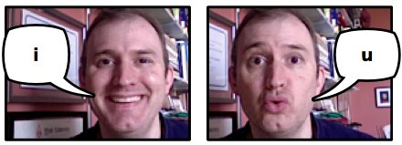
Feature: lip rounding
Some vowels are rounded, meaning they are produced with rounded lips. MOO.
Some vowels are unrounded. MEE.
http://voiceguy.ca/wp-content/uploads/2012/03/overarticulation.jpg

Slide 9
Which of these vowels are rounded?
MOW
MAY
PUT
PUTT
MET
PIT
MAMA
MOP

Slide 10
Which of these vowels are rounded?
MOW rounded
MAY unrounded
PUT rounded
PUTT unrounded
MET unrounded
PIT unrounded
MAMA unrounded
MOP Singapore, UK: rounded US: unrounded

Slide 11
More features
Make a slide between EE and AHH.
Now do it again, really slowly.

Slide 12
More features
Make a slide between EE and AHH.
Now do it again, really slowly.
Did you notice that you go through some other English vowels on the way down?
Also, what did you notice your mouth doing?

Slide 13
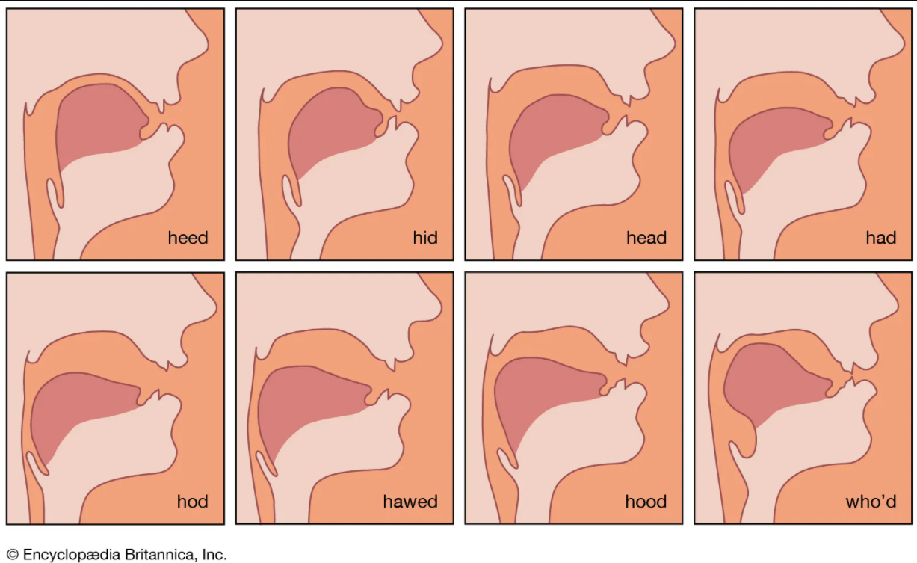
Feature: height
https://cdn.britannica.com/48/4348-050-74DE4D6B/Diagram-tongue-position-vowel-words-language-head.jpg

Slide 14
Feature: height
[i] is a high vowel (aka “closed”)
[ɛ] is a mid vowel
[ɑ] is a low vowel (aka “open”)
This three-level height division is arbitrary, but common because it captures the key vowel distinctions in most languages.
On the full IPA chart there are four height divisions.

Slide 15
Feature: frontness
Let’s go back to [i] and [u]. Before, we talked about lip rounding.
But there is another difference!
[i] is a high front vowel.
[u] is a high back vowel.

Slide 16
Feature: frontness
Frontness (or “advancement”) refers to horizontal movement of the tongue body.
https://cdn.britannica.com/48/4348-050-74DE4D6B/Diagram-tongue-position-vowel-words-language-head.jpg

Slide 17
Feature: frontness
We usually distinguish three levels of frontness:
Front
Central (remember, “mid” was used for height)
Back

Slide 18
Practice: features
Say PET vs. PUTT:
Which one is a front vowel?
Say LOGO vs. LOG:
Which one is lower?

Slide 19
Practice: features
Say PET vs. PUTT:
Which one is a front vowel? PET
Say LOGO vs. LOG:
Which one is lower?

Slide 20
Practice: features
Say PET vs. PUTT:
Which one is a front vowel? PET
Say LOGO vs. LOG:
Which one is lower? LOG

Slide 21
Feature: tense vs. lax
Some languages have a vowel length distinction:
Japanese: obasan vs. obaasan.
In many varieties of English, we distinguish between tense vowels and lax vowels.
Tense vowels: more extreme tongue position, longer duration. Produced with greater articulatory effort.
Lax vowels: less extreme tongue position, shorter. Produced with less effort.

Slide 22
Feature: tense vs. lax
Singapore English doesn’t have a tense-lax distinction.
As a result, some pairs of vowels that are distinct in UK English are not distinct for many speakers of Singapore English.
See if you pronounce these pairs differently:
TEEN, TIN
FOOL, FULL
CAUGHT, COT

Slide 23
Feature: tense vs. lax
Singapore English doesn’t have a tense-lax distinction.
As a result, some pairs of vowels that are distinct in UK English are not distinct for many speakers of Singapore English.
See if you pronounce these pairs differently:
TEEN, TIN
FOOL, FULL
CAUGHT, COT
(All first words in the above pairs are tense, second are lax, as pronounced in standard UK English.)

Slide 24
Feature: tense vs. lax
In English, one-syllable words that end in vowels can typically only end in tense vowels.
Tense vowel words: “me”, “mow,” “too”, “may”
Lax vowel interjections: “meh.” “uhhh”

Slide 25
Feature: tense vs. lax
Note: for some vowels, particularly [ɑ] and [ɔ], not all linguists agree whether they should be classified as tense or lax.
The tense-lax distinction is only relevant for certain pairs of vowels.
Typically, [ɔ:] is classified as tense in UK English and paired with its lax neighbor [ɒ] (e.g., “bought” vs. “bot”), while [ɔ] is classified as lax in US English and paired with its tense neighbor [o] (e.g. “boat” vs. “bought”).
We won’t be testing you on whether [ɑ] or [ɔ] are tense or lax.

Slide 26
Feature: tense vs. lax
So, you may see some textbook or online materials that divide up tense vs. lax vowels differently.
Please stick with the tense vs. lax categories we will learn in lecture, to preserve your sanity.

Slide 27
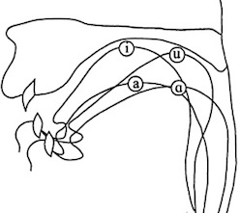
Representing the vowel system
The two dimensions of height and frontness form a little trapezoid inside the mouth:

Slide 28
Representing the vowel system
The two dimensions of height and frontness form a little trapezoid inside the mouth:

Slide 29
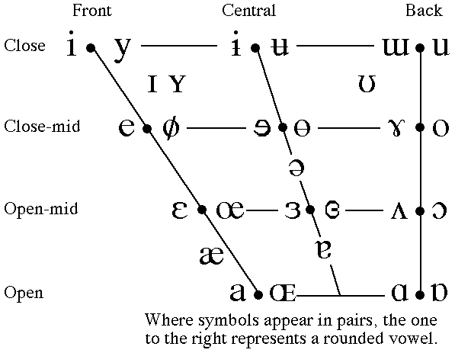
Full IPA vowel chart

Slide 30
Full IPA vowel chart: symbols you need to know

Slide 31
Where is tense vs. lax?
Notice that this chart represents only:
Height
Frontness
Roundedness (rounded vowels are to the right of each dot)
Tense vs. lax is not represented on the chart.

Slide 32
Are these all the vowels?
The IPA chart represents all monophthongs:
vowels which are produced in a steady state from start to finish.
Many languages (including English) also contain diphthongs:
vowels which move from one state to another.
MY, JOY, COW, etc.
More on this in a bit!

Slide 33
Summary: vowel features
Lip rounding: rounded, unrounded
Height: high, mid, low
Frontness: front, central, back
Tenseness: tense, lax
Monophthongs vs. diphthongs

Slide 34
Question: how many possible vowels are there?

Slide 35
The infinite vowel space
Technically, there are an infinite number of possible vowels produced in slightly different positions.
We divide them into categories using the IPA, but this is not 100% precise.
This is one factor that makes IPA transcription for vowels a bit variable: for some vowels, it is not totally clear which transcription is best.

Slide 36
Variable vowels
Vowels are particularly prone to variation between different people, regions, etc.
Vowels also vary depending on what surrounds them: BAT, BAG.
Often, instead of a narrow (precise) transcription, it makes more sense to use a broad transcription to get a consistent IPA symbol across slightly different instances of the “same” vowel.

Slide 37
A note about Singapore and vowels
Singapore English pronunciation developed with influence from Malay and Chinese dialects.
There are a few vowel shifts, mergers, and splits when compared to UK English:
Shift: a vowel has changed position and thus sounds different.
Merger: Vowels that used to be distinct have been merged into a single vowel.
Split: One vowel splits into two vowels.

Slide 38
A note about Singapore and vowels
This is not unusual – all dialects of English (including UK English) have vowel system changes over time.

Slide 39
So what are we learning for this course?
You should be able to identify the key phonetic features that distinguish US, UK, and Singapore English.
We are going to learn the vowel systems of:
Standard US English (aka “General American”)
Standard UK English (aka “Received Pronunciation”)
Singapore English

Slide 40
General American vowels
 | front | central | back
high | i ɪ |  | u ʊ
mid | e ɛ | ə ɜ | o ɔ
low | æ a | ʌ | ɑ

Slide 41
General American vowels
 | front | central | back
high | i ɪ |  | u ʊ
mid | e ɛ | ə ɜ | o ɔ
low | æ a | ʌ | ɑ
Only appear
in diphthongs

Slide 42
General American vowels
 | front | central | back
high | i ɪ |  | u ʊ
mid | e ɛ | ə ɜ | o ɔ
low | æ a | ʌ | ɑ
rounded

Slide 43
General American vowels
 | front | central | back
high | i ɪ |  | u ʊ
mid | e ɛ | ə ɜ | o ɔ
low | æ a | ʌ | ɑ
lax

Slide 44
GenAm Monophthongs
[i] sheep, key, seize
[ɪ] ship, kit, rip
[ɛ] set, mess
[æ] trap, ham, arrow
[u] goose, few, who
[ʊ] foot, full, look, could
[ʌ] strut, cub, hum
[ɔ] thought, hawk
[ɑ] lot, stop, calm
[ɜ] nerd, hurt [only occurs before r in stressed syllables]
[ə] writer, accomplish [for unstressed, reduced vowels]

Slide 45
GenAm Diphthongs
[aɪ] my, side, aisle, choir
[eɪ] face, weight, steak
[ɔɪ] boy, coin
[aʊ] mouth, crowd, flower
[oʊ] goat, sew, stove
NOTE: Diphthongs are considered tense due to longer duration and greater articulatory effort.

Slide 46
Postvocalic r
Standard US English is “rhotic”, meaning that [r] following a vowel is retained.
[r] often changes the sound of the preceding vowel, making it tricky to transcribe. Here are standard US transcriptions:
[ir] near, deer
[ɜr] nurse, turn
[ər] writer, biker
[ɛr] there, hair
[ɔr] north, boar
[ʊr] tour, moor
[jɜr] Europe, pure
Note: sometimes people write a little diacritic on the vowels instead of the full [r], like this: ɝ

Slide 47
GenAm examples
What words are these?
(1) [feɪvər]
(2) [bɜrnɪŋ]
(3) [ɪntɛnʃənəl]
(4) [θaʊzənd]

Slide 48
GenAm examples
What words are these?
(1) [feɪvər] favor
(2) [bɜrnɪŋ] burning
(3) [ɪntɛnʃənəl] intentional
(4) [θaʊzənd] thousand

Slide 49
GenAm examples
What is this sentence:
[oʊ maɪ gɔd kɛrən ju kænt jəs æsk pipəl waɪ ðeɪr waɪt]

Slide 50

GenAm examples
What is this sentence:
[oʊ maɪ gɔd kɛrən ju kænt jəs æsk pipəl waɪ ðeɪr waɪt]
“Oh my God, Karen, you can’t just ask people why they’re white.” (Mean Girls)

Slide 51
Received Pronunciation
Received Pronunciation refers to a type of educated, “posh” UK English that we think of as the standard (although most Brits don’t really speak this way).
Still, the basic vowels apply to most educated English people, particularly those in the South.
The accent most common in Southern Britain today is Southern Standard British English (SSBE).
All vowels in UK English differ in subtle ways from US English, but only a subset differ enough to require different IPA.

Slide 52
RP vowel chart
 | front | central | back
high | i ɪ |  | u ʊ
mid | e ɛ | ə ɜ | ɔ
low | æ a | ʌ | ɒ ɑ

Slide 53
RP vowel chart
 | front | central | back
high | i ɪ |  | u ʊ
mid | e ɛ | ə ɜ | ɔ
low | æ a | ʌ | ɒ ɑ
where
did [o]
go?
new
vowel

Slide 54
RP vowel chart
 | front | central | back
high | i ɪ |  | u ʊ
mid | e ɛ | ə ɜ | ɔ
low | æ a | ʌ | ɒ ɑ
rounded

Slide 55
RP vowel chart
 | front | central | back
high | i ɪ |  | u ʊ
mid | e ɛ | ə ɜ | ɔ
low | æ a | ʌ | ɒ ɑ
lax

Slide 56
US vs. UK differences
US UK
lot: [ɑ] [ɒ]
law: [ɔ] [ɔ:] (‘:’ means long)
class: [æ] [ɑ]
coat: [oʊ] [əʊ]

Slide 57

RP: Postvocalic r
When r comes after a vowel and before a pause or a consonant, it is deleted and realized as a schwa [ə] or replaced with a long vowel (indicated with :).
near [nɪə]
care [kɛə]
cure [kjʊə]
curse [kɜ:s]
horse [hɔ:s]
biker [baɪkə]

Slide 58
NOTE: Alternative IPA conventions in British English
To indicate the difference between tense and lax vowels, some UK phoneticians add the length diacritic to all of the tense vowels (e.g., [i:]).
Some UK phoneticians use [e] for [ɛ] and [a] for [æ].
We won’t be using either of these conventions in this course.

Slide 59
RP Practice
What IPA symbol(s) represent the vowel in US and UK English?
(1) bath
(2) trap
(3) glow
(4) shop

Slide 60
RP Practice
What IPA symbol(s) represent the vowel in US and UK English?
US UK
(1) bath [æ] [ɑ]
(2) trap [æ] [æ]
(3) glow [oʊ] [əʊ]
(4) shop [ɑ] [ɒ]

Slide 61
RP Practice
What sentence is this?
[ðə neɪmz ʃɜ:lɒk həʊmz ən ði ədrɛs ɪz tu tu wʌn bi beɪkə strit]

Slide 62
RP Practice
What sentence is this?
[ðə neɪmz ʃɜ:lɒk həʊmz ən ði ədrɛs ɪz tu tu wʌn bi beɪkə strit]
“The name’s Sherlock Holmes and the address is 221B Baker Street.”

Slide 63
Reminder: RP vowel chart
 | front | central | back
high | i ɪ |  | u ʊ
mid | e ɛ | ə ɜ | ɔ
low | æ a | ʌ | ɒ ɑ

Slide 64
Singapore Eng. vowel chart
 | front | central | back
high | i |  | u
mid | e ɛ | ə | o ɔ
low |  | a

Slide 65
So many mergers!
Mergers of several vowels
[ɪ] → [i]
[ʊ] → [u]
[æ] → [ɛ]
[ʌ] → [a]
[ɒ] → [ɔ]

Slide 66
Diphthongs
Unlike GA and RP, SingE has monophthongal [e] and [o]:
plate [plet]
loaf [lof]
Diphthongs:
[ai] my, bite
[ɔi] boy, soil
[au] now, out
[iə] here, near
[uə] poor, sure

Slide 67
Postvocalic r
Most Singaporeans delete postvocalic r, as in RP.
But more and more young people do not, particularly in careful speech.
squares [skwɛz], [skwɛrz]

Slide 68
Tense vs. Lax?
Singapore English is not considered to have a tense-lax distinction, in terms of the articulatory effort and length with which vowels are produced.
The vowel pairs [e] vs. [ɛ] and [o] vs. [ɔ] are just distinguished by their position (high-mid vs. low-mid).

Slide 69
SingE Practice
Identify these words transcribed in SingE:
[krɛʃ]
[postə]
[tʃans]
[kɔfiŋ]
[ʃautəd]
[fiə]

Slide 70
SingE Practice
Identify these words transcribed in SingE:
[krɛʃ] crash
[postə] poster
[tʃans] chance
[kɔfiŋ] coughing
[ʃautəd] shouted
[fiə] fear

Slide 71
Summary
Example | US - GA | UK - RP | SingE
SHEEP | i | i | i
SHIP | ɪ | ɪ | i
SET | ɛ | ɛ | ɛ
TRAP | æ | æ | ɛ
CLASS | æ | ɑ | a
GOOSE | u | u | u
FOOT | ʊ | ʊ | u
STRUT | ʌ | ʌ | a
THOUGHT | ɔ | ɔ: | ɔ
LOT | ɑ | ɒ | ɔ
COMMA | ə | ə | ə

Slide 72
Summary (cont’d)
Example | US (GA) | UK (RP) | SingE
MAY | eɪ | eɪ | e
MY | aɪ | aɪ | ai
BOY | ɔi | ɔi | ɔi
MOW | oʊ | əʊ | o
NOW | aʊ | aʊ | au
NEAR | ir | ɪə | iə
SQUARE | ɛr | ɛə | ɛ(r)
TOUR | ʊr | ʊə | uə(r)
PURE | jɜr | jʊə | jo(r)
NORTH | ɔr | ɔ: | ɔ(r)
START | ɑr | ɑ: | a(r)
NERD | ɜr | ɜ: | ə(r)
WRITER | ər | ə | ə(r)

Slide 73
Some resources
Summary of English sound system: http://en.wikipedia.org/wiki/English_phonology
Chart contrasting IPA for English dialects (including Singapore English): http://en.wikipedia.org/wiki/International_Phonetic_Alphabet_chart_for_English_dialects

Slide 74
Some resources: Soundy stuff
Full interactive IPA chart: https://www.seeingspeech.ac.uk/ipa-charts/
US English IPA with sounds: https://americanipachart.com/

Slide 75
Apps
Android:
Pronunroid https://play.google.com/store/apps/details?id=com.hoardingsinc.pronunroid
iPhone:
iPA Phonetics: https://itunes.apple.com/us/app/ipa-phonetics/id869642260?ls=1&mt=8
If you find any other useful apps, please let us know!

Slide 76
Note: variations in IPA
You will see that some sources use slightly different IPA notation, or use different terms for some phonetic features.
These differences are due to pronunciation variation, the imprecise nature of the IPA system, and preferences for more narrow or broad transcription.
Don’t freak out.

Slide 77
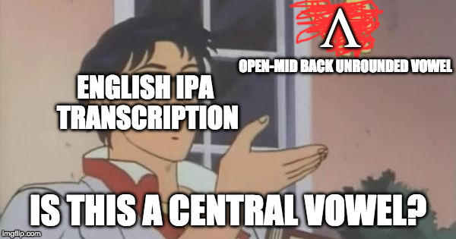
Note: variations in IPA
One thing you might notice: [ʌ] on the full IPA chart is listed as a back vowel, but in English it is used to transcribe a central vowel.
Although IPA is intended to be universal, in fact there are little idiosyncrasies like this in transcription conventions within languages.

Slide 78
Lexical Stress
Stress: emphasis placed on a particular linguistic unit.
“You want me to do what?”
Lexical stress: emphasis placed on a particular syllable within a word.
Next week, more about syllables
In English, stress is very important in distinguishing between certain words.
e.g., insight vs. incite

Slide 79
How is lexical stress realized?
Stressed syllables are higher, louder, and longer than unstressed syllables.
The vowels of unstressed syllables are likely to be reduced (produced as schwa [ə]).
Examples:
accountable [əˈkaʊntəbəl]
recent [ˈrisənt]

Slide 80
Types of stress
Primary stress:
All words* have one syllable that receives primary stress.
We mark primary stress in IPA with a straight apostrophe (ˈ) before the syllable.
collect [kəˈlɛkt]
Marking stress is optional in IPA.
In connected speech, one-syllable function words (e.g. ‘and’, ‘of’, ‘for’) are often unstressed.
“cats and dogs” [ˈkæts ənd ˈdɔgz]

Slide 81
Types of stress
Secondary stress:
Longer words sometimes have syllables receiving secondary stress, an intermediate level of stress.
Secondary stress is marked with a low apostrophe (ˌ)
organization [ˌɔrɡənɪˈzeɪʃən]

Slide 82
Stress patterns in English
English has many word pairs like the following. Can you see a pattern?
record: [ˈrɛkərd], [rəˈkɔrd]
address: [ˈædrɛs], [əˈdrɛs]
import: [ˈɪmpɔrt], [ɪmˈpɔrt]

Slide 83
Stress patterns in English
English has many word pairs like the following. Can you see a pattern?
record: [ˈrɛkərd], [rəˈkɔrd]
address: [ˈædrɛs], [əˈdrɛs]
import: [ˈɪmpɔrt], [ɪmˈpɔrt]
The version with initial stress is a noun, while the verb has final stress.

Slide 84
Stress in Singapore English
Stress works a bit differently in Singapore English than in US/UK English.
Unstressed syllables do not lower in pitch or shorten as much, and there is less vowel reduction.

Slide 85
Practice
Where is the primary stress in these words:
surroundings
taxidermy
linguist
linguistics
phonetics
phonological
Singapore

Slide 86
Practice
Where is the primary stress in these words:
surroundings
taxidermy
linguist
linguistics
phonetics
phonological
Singapore

Slide 87
Key Concepts for Phonetics
The speech chain
The vocal tract
Consonants: voicing, place of articulation, manner of articulation.
Vowels: lip rounding, height, frontedness, tenseness, monophthong vs. diphthong.
Key differences in US, UK, and Singapore English pronunciation.
Stress: primary, secondary stress.

Slide 88
Next week
Phonology!

